Slide 1
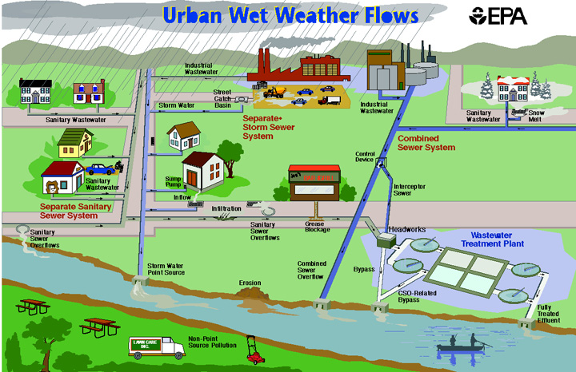
Modifications to the Storm Water Ordinance
The City Municipal Separate Storm Sewer System (MS4) drains rainwater and all runoff into natural streams.
EPA’s Clean Water Act requires that a MS4 operate under a NPDES Permit.
When the City violates its NPDES permit, it can be FINED.
WHEN IT RAINS
IT DRAINS

Slide 2
Modifications to the Storm Water Ordinance have strengthened the City of Mobile’s authority to
SAMPLE
INSPECT
and ENFORCE
the requirements of the ordinance.

Slide 3
New Construction and Redevelopment
Land Disturbance Permit for sites 1 acre or greater (“Qualifying Sites”):
Additional requirements target maintenance of storm water management for the life of the project.

Slide 4



Commercial, Industrial, & High Risk Facilities
New Requirements include:
Implementation and maintenance of Best Management Practices (BMPs) to reduce pollution in storm water
Copy the City on all NPDES Permit submittals to ADEM (i.e. Discharge Monitoring Reports and Non-Compliance Reports)

Slide 5




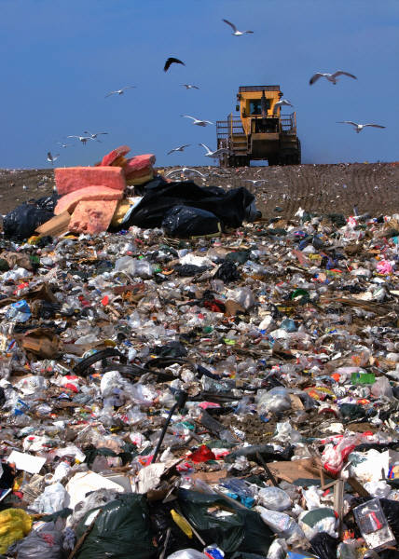
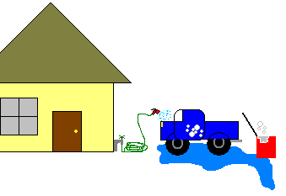



Illicit Discharge Detection and Elimination (IDDE)
Sand, Motor Oil, Leaves, Garbage, and Pool Water (Salt or Chlorine) are some examples of Illicit Discharges.
The list of exceptions for non-stormwater discharges includes (but is not limited to):
Pressure Washing
Residential Car Washing
Firefighting
Landscape Watering

Slide 6
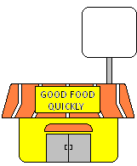

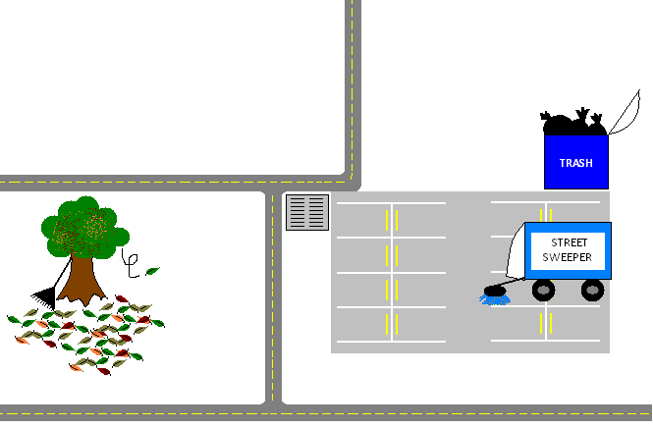
Examples of City-Wide Best Management Practices (BMPs)
Litter should be removed daily.
Keep dumpster areas clean.
Catch basins and drains should be inspected & maintained regularly.
Leaves should be swept or vacuumed—NOT put down drains.
Remove sediment/debris/trash from parking lot regularly.

Slide 7
Determine
Training Requirements
Complete Inspections and Sampling
Begin Training
Implement
New Program
Gather Documentation
Determine Operational Changes
Evaluate for Effectiveness
Prepare Annual Report
Initial Plan Review and Approval
Draft SWMP and Permit Preparation
Initial Phase
The Planning Process
Information and Data Gathering

Slide 8
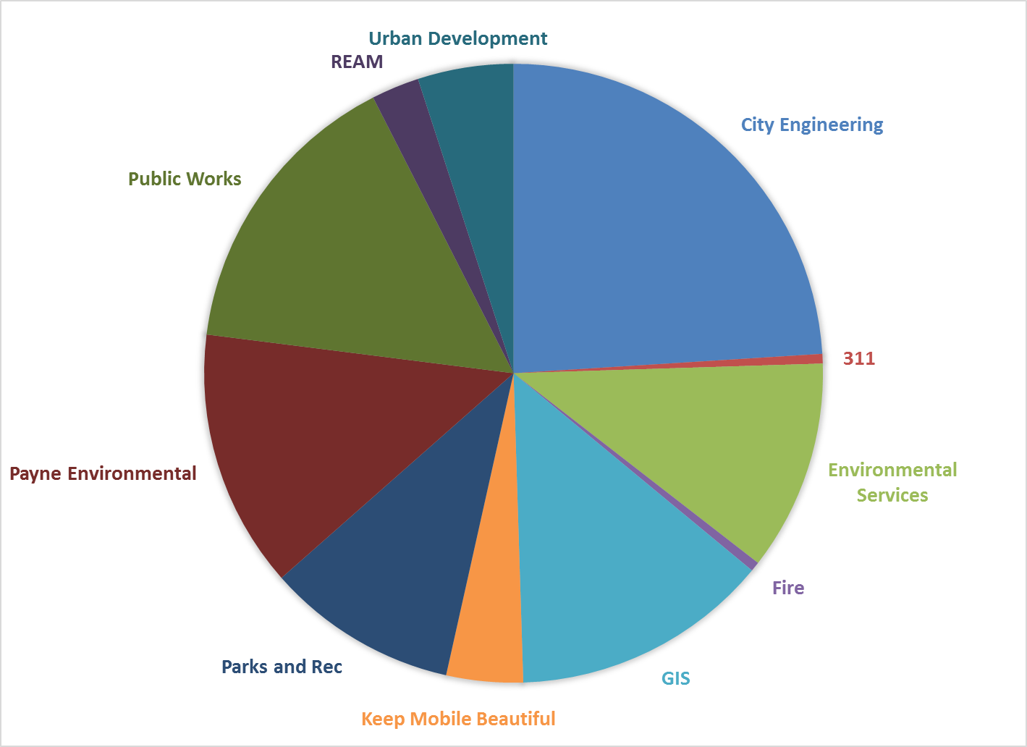
MS4 Responsibilities by Department

Slide 9
Questions?

Slide 10
New Construction and Redevelopment
New Classification for Land Disturbance Permits
Tier 1 for Sites 1 acre or greater ---Tier 2 for Sites less than 1 acre
Effective September 30th, 2014 No Change
Construction Phase for Tier 1 Sites
More detailed Construction Best Management Practices (CBMP Plan)
Contractor notifies City when construction commences
Security required- letter of credit, surety bond, or cash bond, to secure performance of BMPs
Security released when site is stable and accepted by the City for Certificate of Occupancy
Maintenance Phase for Tier 1 Sites
Maintenance easement
Maintenance covenant
Property owner agrees to conduct annual inspections of Best Management Practices (BMPs) *Effective 1 year following new NPDES permit
Property owner submits inspection records to the City *Effective 1 year following new NPDES permit

Slide 11
City of Mobile
MS4 Overview
Storm Water Management Program Plan (SWMPP)
Required by NPDES Permit to avoid fines
Adjusted annually with Annual Report submitted to ADEM.
Completed by Payne Environmental Services
Reviewed by City
Expected approval date is June 2014
To be posted on City’s website
New NPDES Permit from ADEM/EPA
Driven by Clean Water Act and federal law
City has commented on ADEM draft permit
ADEM sent draft permit to EPA for approval
ADEM issues draft permit for public comment and will respond to comments
Expected issuance date of new NPDES Permit is September 2014
Revised Storm Water Ordinance
Permit & SWMPP requires the new ordinance to be in effect by September 2014
Relevant departments required for enforcement of new ordinance:
Environmental Services
Engineering
Urban Development
Fire Department – Hazardous Materials Response
311 System
Municipal Court
Police
Annual Report
Required to be submitted by January 31st by NPDES Permit to avoid fines
Summary of how SWMPP was implemented, evaluation of program effectiveness, and interpretation of storm water monitoring results.
Fiscal Year: October 1 – September 30
To be implemented by City and Payne Environmental Services when approved by ADEM

